Slide 1


[HITT, HANKINSON, ANDERSEN, D’SOUZA – RADAR]
GROUP 32

Slide 2

INTRODUCTION
2HAD-RAD is a handheld system designed to assist search-and-rescue teams by detecting human presence and estimating the location of individuals in real time. The device identifies indicators of life such as movement, breathing, and body heat and provides responders with visual alerts and positional information to support rapid decision-making in complex environments.

Slide 3
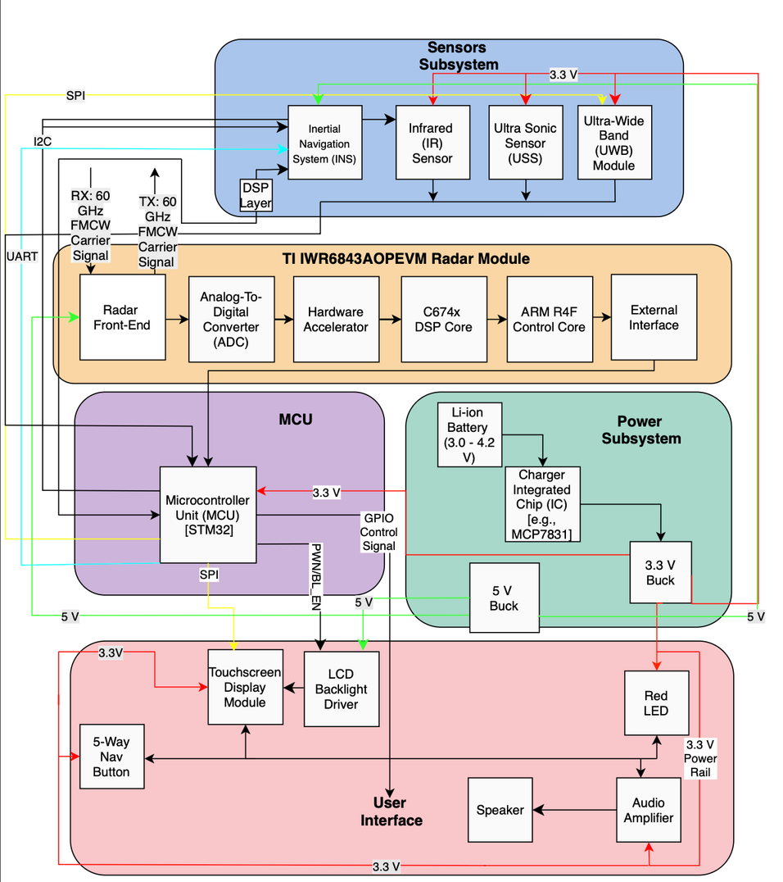
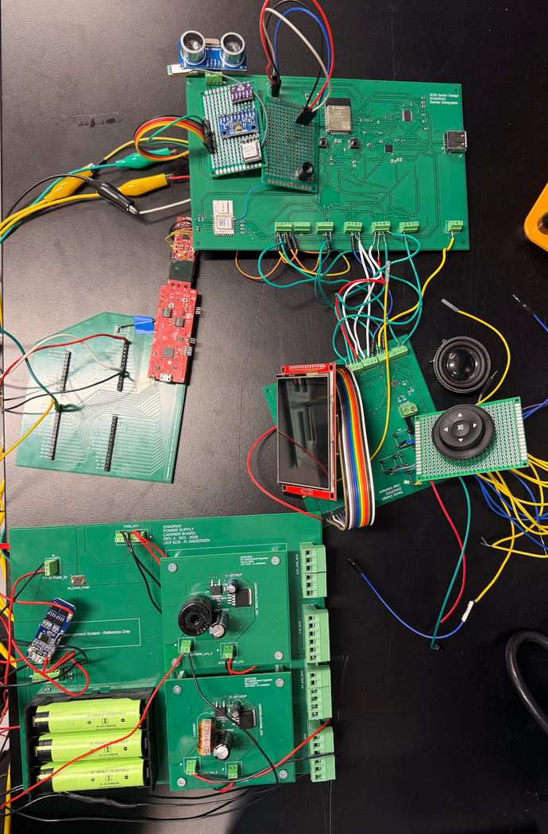
HARDWARE BLOCK DIAGRAM

Slide 4
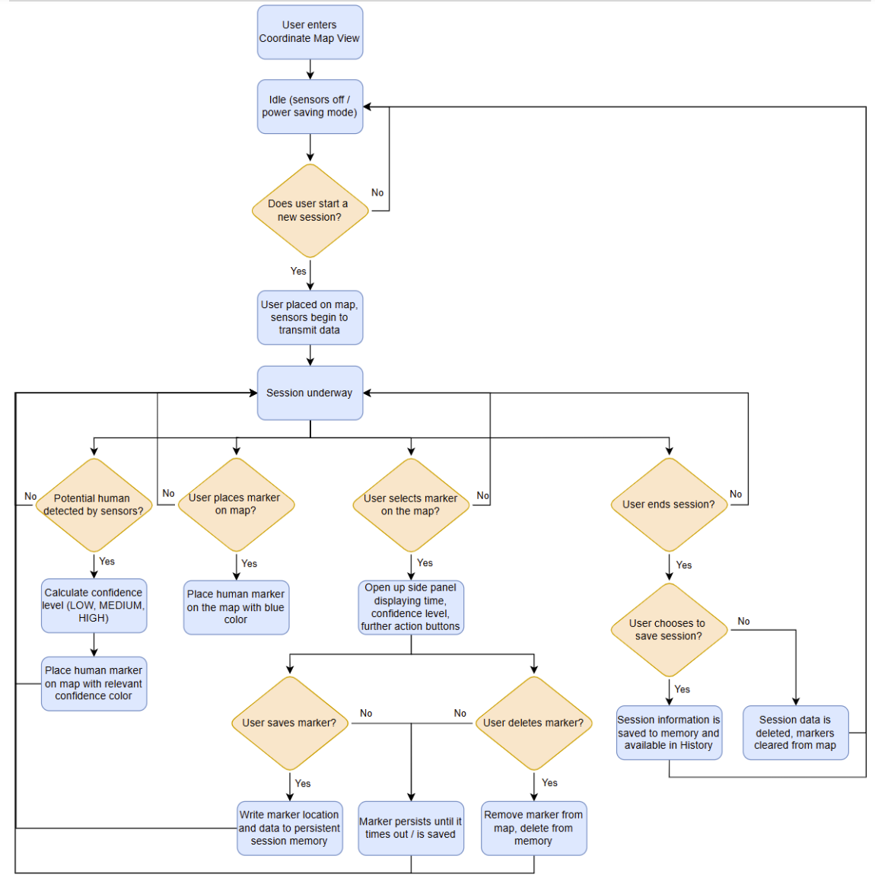
SOFTWARE BLOCK DIAGRAM

Slide 5
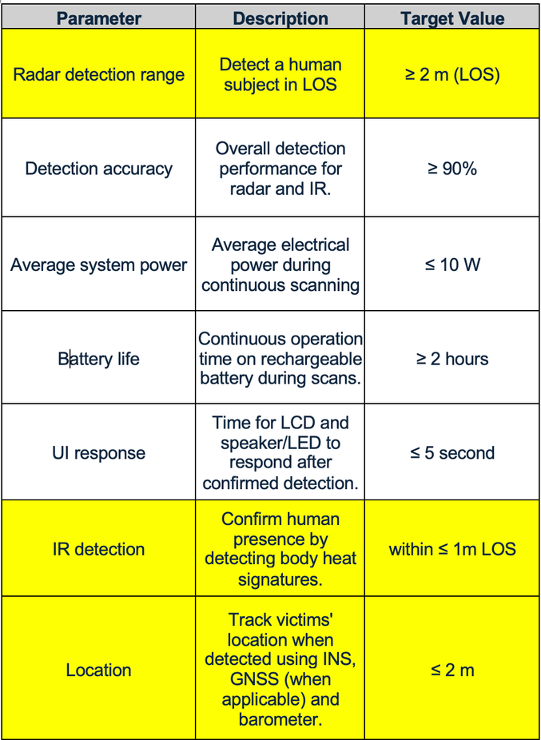
ENGINEERING SPECIFICATIONS

